Slide 1

Da Costa I.E.T.

Slide 2
*Disclaimer*
This book is intended for adult audiences. All readers or viewers must be 18 years or older. By looking at or reading this presentation, you are confirming that your are at least 18 years or older.
We are not Medical doctors or licensed to practice psychology, and “Pompoir: A Manual to Train and Control the Pelvic Floor”, is not intended to substitute for psychological counseling or medical treatment for any condition. It is simply an exercise philosophy based on ancient exercise techniques, experience and the thousands of women who have contacted us.
The use of information in this presentation is responsibility of the reader and acting on the suggestions and advice in this presentation and in performing the exercises, you waive all rights to all and any type of lawsuit against the author.

Slide 3
All rights reserved. No part of this publication may be reproduced or transmitted in any form by any means electronic or mechanical, including photocopying and recording, or introduced to any information storage and retrieval system without written permission of the copyright owner of this manual.

Slide 4
What is pompoir?
The ultimate sex-ercise of all time!
Pompoir is the art of training and controlling the pelvic floor.
Originated from a technique called sahajoli, an ancient Indian tradition that includes, among other things, elements from a secret training once known only to Indian temple dancers and Hindu Devadassi and Greek courtesans. Pompoir is referenced as “holding firm” in Taoism, “kabazza,” or “the velvet grip” in the Arabic language, and in the Far East as the “Singapore kiss.”
Women learn to identify and isolate individual muscles. Acquiring the ability to control such actions as pulsing, squeezing, draw in (like milking a cow) and twisting just by controlling your pelvic muscles when your partner is inside of you to bring him to ultimate orgasmic bliss.
Conscientious and continued training in this way is what made the Japanese Geishas and Thai courtesans so sexually talented; allowing them to propel small objects and extinguish burning candles with their vaginas.
Enjoy this great genital fitness program, as it builds powerful sexual skills, whether you are a young or postmenopausal woman or anywhere inbetween.

Slide 5
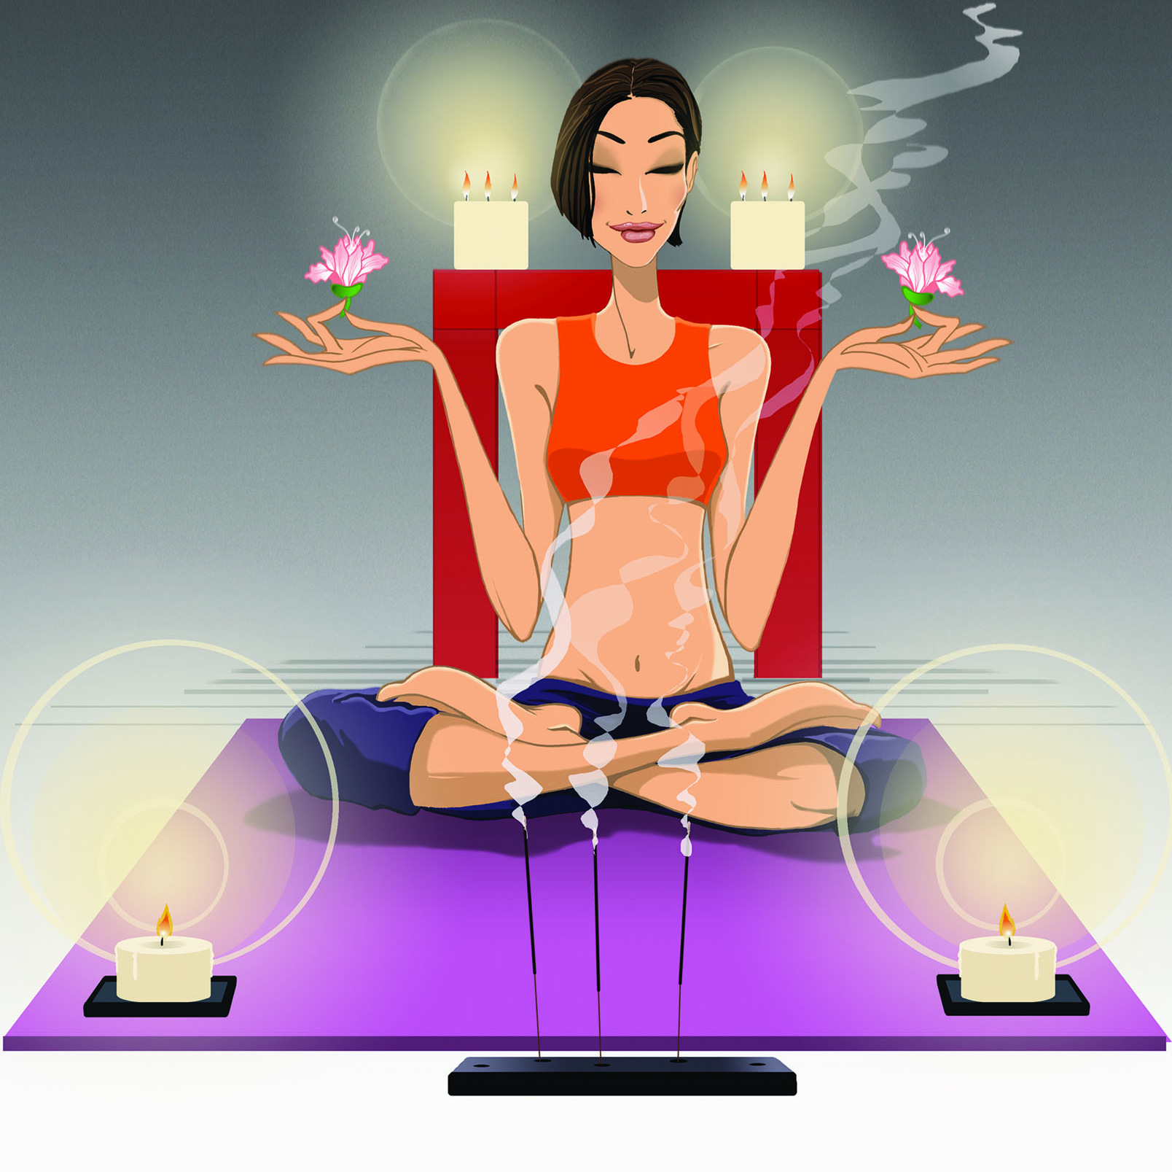
benefits of Pompoir
* Strengthens vaginal walls
* Restores vaginal tightness
* Controls vaginal muscles
* Facilitates orgasms during
penetration
* Enables multiple orgasms
* Awakens sexual desire
* Helps prepare for childbirth

Slide 6

Here is what people say of pompoir
“Better for a man than oral sex”
“Men lucky enough to be with a woman trained on this technique, will experience the most delicious sexual nirvana.”
“It’s like having a warm, velvet glove wrapped around the penis, stroking and gripping and twisting your partner into a pleasure heaven “

Slide 7

What you need for pompoir.
* A Private space
* A Clean Towel
* A Mirror
* Pleasure Pods
* Ben Wah Balls
* Cylindrical Vibrator

Slide 8
THE SECRET TO SUCCESS
Promote success by protecting your privacy; I advise all of my students to create a safe emotional space as beginner in the Art of Pompoir. Taking this journey is a very personal decision and you should only start to share with your partner when you feel comfortable doing so. The first few parts of the training are a delicate and vulnerable self exploration, and they deserve the protection of privacy. Do not worry, you will have plenty of time to share with your partner with greater strength and confidence.
Be Persistent Practice leads to perfection and by consistent practice you will build the skills you need to master the Art of Pompoir. Go slow but keep going. Follow the guidelines of the chapters. Ss you repeat the exercises, you will see that your awareness and control will grow as you discover areas of pleasure, building your skills at the same time. Don’t forget to be kind and encouraging to yourself.
Be Patient. Learning new skills requires patience; the first time you explored your sexuality or masturbated may have felt good but probably you were unsure exactly how to build this pleasure into an orgasm. The same is true for training your PC muscles and learning the Art of Pompoir. Give it time and allow experience to develop your skills. Enjoy each stage of growth, and don’t worry about the “grand finale”.

Slide 9
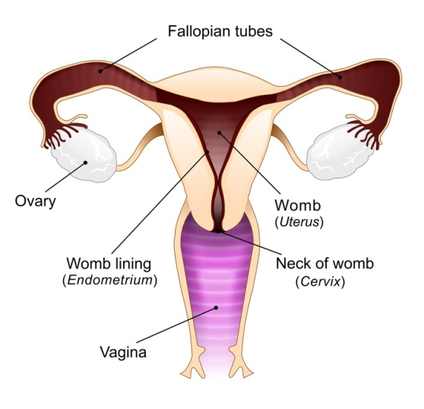
The pc muscles
The pubococcygeous
or PC muscles, are the muscles we will be working on to give you Pompoir abilities
So, let’s help you find your PC muscles.
The best way know to find your PC muscles is to stop the flow of urine for several times as you sit on the toilet; be sure to keep your legs wide open to avoid the muscles from the buttocks sending confusing signals.
Let’s break this into steps to help make the muscles easier to find.
Step 1: Sit on the toilet (preferably in the comfort of your home)
Step 2: Spread your legs as much as you can
Step 3: Try to stop the urinary flow. Do this several times until you can clearly feel the muscles you are using to stop the flow. Those muscles are the PC muscles.
Another option, if you are a woman, is to insert your finger into your vagina (not too far in) and try to squeeze it with the muscles surrounding it. If you feel your vagina tighten and the muscles of your pelvic floor move up and then down as you release the contraction, you're doing it correctly

Slide 10
Proper breathing
It’s important to stay relaxed during these exercises. One way to help stay relaxed is to maintain proper breathing.
Step 1. Imagine that you have balloon in your belly. Still concentrating your mind on your genitals, breathe in through your nose, filling that imaginary balloon with air. Exhale slowly. Repeat this ten times.
Step 2. Now inhale through your nose, and exhale through your mouth. As you proceed, you will inhale as you tighten your muscles, and exhale as you relax your muscles.

Slide 11
ALWAYS ALWAYS ALWAYS
Warm Up
After amassage, you should be feeling extremely relaxed. Remain reclined. Inhale and contract your vaginal muscles vigorously, feeling the pressure inside; exhale and relax the muscles. Contract and relax your pelvic muscles for another 3 sets of 5 times. Rest for 30 seconds or so, then repeat the warm-up for 3 sets of 10 times; rest 30 seconds again, and repeat the warm-up for 3 sets of 15 times. Remember to breathe as instructed earlier: inhale/contract, exhale/relax.
NOTE: Do not rush when executing these movements. It should be calming like when doing yoga. If you have never done yoga, just execute the movements calmly, and do not rush.
Stretch
It is just as important to warm up before beginning your exercise cycles as it is important to stretch and relax after your routine
Stretch exercise routine
Phase I: Relax the vaginal muscles by squatting on the floor. Do not contract the vaginal muscles. Now place the weight of your body on your flexed thighs, count to 21, and enjoy the feeling of relaxation.
Phase II: Lying on your back, place your feet on the wall, contract your vagina, anus, and stomach. Hold the contraction and slowly let your feet climb the wall until your body is elevated in such a way that your weigh rests on your shoulders or as high as you can. Count to 21 while relaxing.

Slide 12

Building your exercise routine
How to execute your training routine.
Because every woman is different, some will have more difficulty training their vaginal muscles than others, but continuous training is needed to succeed. We recommend that you read the sequence and cycles before you perform them.
Start your exercise routine on page 18.
Follow the step by step guide of page 13
where you will found your exercise cycle and sequence.
NOTE: None of the exercises are suppose to cause you any pain or discomfort. If you feel any pain we advise to stop your exercises immediately and see a doctor.
Follow the routine step by step. As soon as you master a phase, pick two new exercises to add to daily practice.
CONSULT A DOCTOR BEFORE ANY TYPE OF EXERCISE IF YOU HAVE ANY CONCERNS.

Slide 13

Exercise cycle 1
Sequence I to IV
Building Strength
Cycle I

Slide 14
Exercise Cycle 1 Sequence I
Step 1. Sit comfortably in a chair. This helps you resist using your gluteus muscles (buttocks). Don’t worry if you find that these muscles still contract somewhat when you tighten your vaginal muscles, however, as this will not ultimately affect your training.
Step 2. Place your hands loosely on your thighs, palms down, keeping your feet on the floor, slightly apart.
Step 3 . Inhale, squeezing your vaginal muscles as though you are holding something inside, then relax the vaginal muscles, exhaling.
Maintain the position and repeat step 3 for a count of 5: So you will:
* Inhale counting to 5 /squeeze, exhale/relax. Repeat this sequence 5 times.
* Let’s steup it up. Repeat the exercise, this time for a count of 10: inhale counting to 10/squeeze, exhale/relax. Repeat this sequence 10 times.
* You are doing well, let’s keep going one more time. This time for a count of 15: inhale counting to 15/squeeze, exhale/relax. Repeat this sequence 15 times.
NOTE: Perform this exercise slowly. There is no hurry. Synchronize your breathing with your actions.

Slide 15
Exercise Cycle 1 - Sequence II
Step 1. Stand with your feet shoulder-width apart and your hands resting comfortably on your hips.
Step 2. Inhale squeezing your vaginal muscles as though you are holding something inside, then relax the vaginal muscles, exhaling. Now Inhale, contracting your vaginal muscles, then relax the vaginal muscles, exhaling. Be sure to differ squeeze of contract – take your time.
Maintain the position and repeat step 2 for a count of 5: So you will:
* Inhale counting to 5 /squeeze, exhale/relax. Inhale conting to 5 contract, exhale/relax. Repeat this sequence 5 times.
* Let’s step it up. Repeat the exercise, this time for a count of 10. Inhale counting to 10 /squeeze, exhale/relax. Inhale counting to 10/contract, exhale/relax. Repeat this sequence 10 times.
* You are doing well, let’s keep going one more time. This time for a count of 15. Inhale counting to 15 /squeeze, exhale/relax. Inhale counting to 15/contract, exhale/relax. Repeat this sequence 15 times
NOTE: Perform this exercise slowly. There is no hurry. Synchronize your breathing with your actions.

Slide 16
Exercise Cycle 1 - Sequence III
Step 1. Still standing with your feet shoulder-width apart and your hands resting comfortably on your hips, ease your pelvis/buttocks backward while inhaling, contracting your vaginal muscles
*Note – Be sure to contract and not squeeze the vaginal muscle.
Step 2. Ease your pelvis/buttocks forward, relaxing the vaginal muscles and exhaling.
Maintain the position and repeat step 1 and 2 for a count of 10: So you will:
* Ease your pelvis/buttocks backward while inhaling/counting to 10, contracting your vaginal muscles. Ease your pelvis/buttocks forward, relaxing the vaginal muscles and exhaling. Repeat this sequence 5 times.
* Let’s step it up. Repeat the exercise, this time for a count of 15. Ease your pelvis/buttocks backward while inhaling/counting to 10, contracting your vaginal muscles. Ease your pelvis/buttocks forward, relaxing the vaginal muscles and exhaling. Repeat this sequence 5 times.
* You are doing well, let’s keep going one more time.. Repeat the exercise, this time for a count of 20. Ease your pelvis/buttocks backward while inhaling/counting to 20, contracting your vaginal muscles. Ease your pelvis/buttocks forward, relaxing the vaginal muscles and exhaling. Repeat this sequence 10 times.
NOTE: Perform this exercise slowly. There is no hurry. Synchronize your breathing with your actions.

Slide 17
Exercise Cycle 1 - Sequence I V
Step 1. Still standing with your feet shoulder-width apart and your hands resting comfortably on your hips, ease your pelvis/buttocks backward.
Step 2. Hold this position for 10 seconds. At the same time, squeeze and release your vaginal muscles rapidly. Inhale as you squeeze and exhale as you release. Take 5 seconds break. And repeat this sequence for 10 minutes
NOTE: Synchronize your breathing with your actions.
NOTE: At the end of this four-phase exercise cycle, you will feel sexually aroused. Not only have you been focusing your mind solely on your erogenous zone, but you have also been performing movements that stimulate the blood flow and excite the nerve endings in the area. Use this exercise any time you want to heat up your mood and fire up your passion.

Slide 18
1st. Week exercise routine
Monday | Tuesday | Wednesday | Thursday | Friday | Saturday | Sunday
Finding your PC Muscle | Warm up | Warm up | Warm up | Warm up | X | X
Learning to Warm up | Exercise Cycle 1- Sequence I to III | Exercise Cycle 1- Sequence I to III | Exercise Cycle 1- Sequence I to III | Exercise Cycle 1- Sequence I to IV | X | X
Learning to Stretch | Stretch | Stretch | Stretch | Stretch | X | X
Beginning your Pompoir Routine | X | X | X | X | X | X

Slide 19



Celebrating being a woman
Email pompoirexpert@gmail.com
Phone: 312.300.6500
Became a fan on face book
* Fallow us on twitter

